Slide 1
Определения

Slide 2
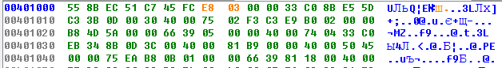
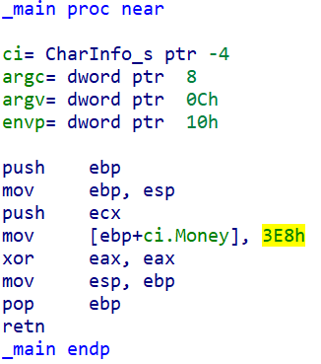
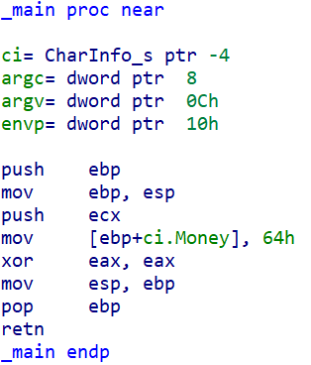
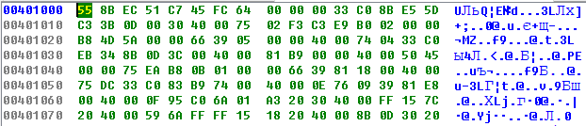
typedef struct CharInfo_s
{
int Money;
} CharInfo_t;
void main()
{
CharInfo_t ci = {100};
}
typedef struct CharInfo_s
{
int Money;
} CharInfo_t;
void main()
{
CharInfo_t ci = {1000};
}

Slide 3
0: eb 03 jmp 0x5 2: 83 c0 03 add eax, 0x3 5: c3 ret
0: 31 c0 xor eax, eax 2: 83 c0 03 add eax, 0x3 5: c3 ret

Slide 4
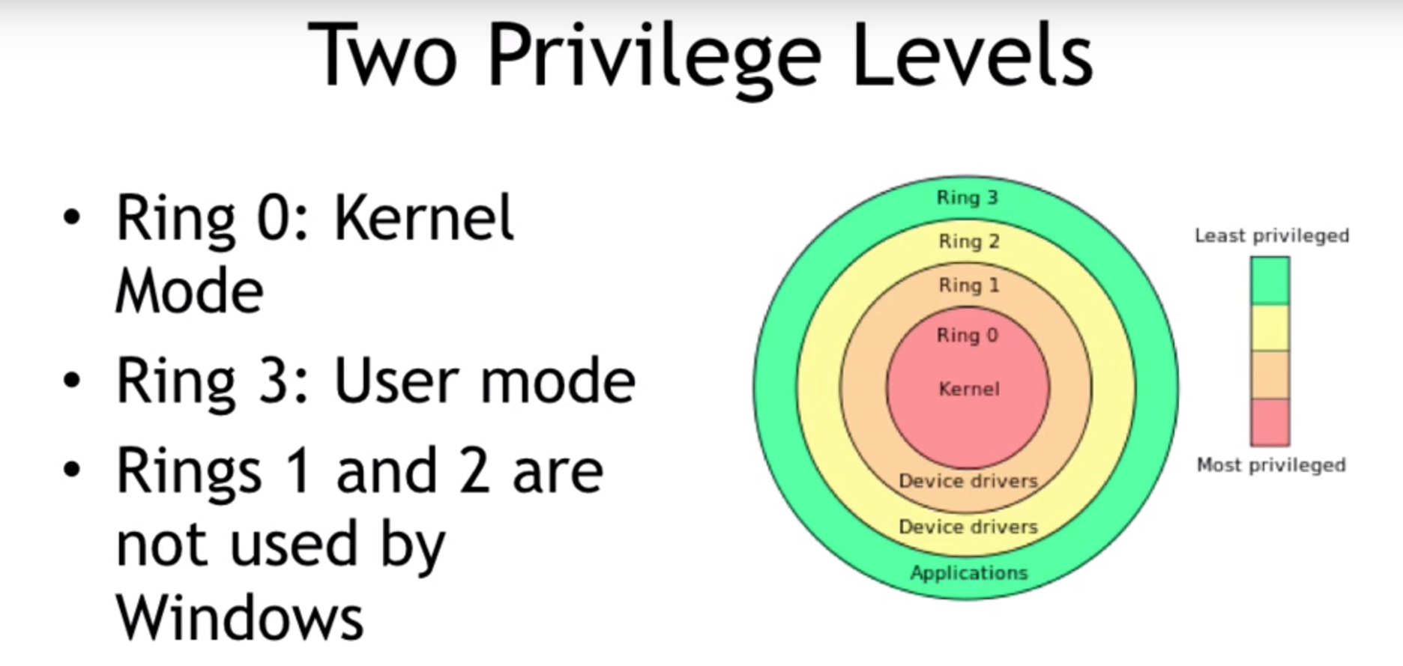

Slide 5
Актуальность

Slide 6

esetnod32 17 октября 2016 в 15:51
Исследование руткита Cremes
Антивирусная защита, Блог компании ESET NOD32
Плагин kgate
Плагин kgate используется в качестве установщика в систему Ring 0 кода как на 32-х, так и на 64-битных версиях Windows. Для 32-битной системы, kgate прибегает к использованию функций драйвера Agnitum Sandbox.sys, который позволяет с использованием специального IOCTL запроса загрузить драйвер руткита в систему.
Плагин xkgate
Для загрузки этого Ring 0 кода авторы Cremes выбрали еще одну жертву — драйвер Avast. Эксплуатация этого драйвера сложнее чем драйвера Agnitum, рассмотрим его более подробно…
После создания процесса aswSnx.exe с остановленным стартовым потоком, функция дублирует открытый дескриптор на устройство \Device\aswSnx из процесса плагина в новый процесс aswSnx.exe. Далее туда же копируется специальный код из секции плагина .avit, которая отвечает за взаимодействие с драйвером Avast. Он выполняет функцию DeviceIoControl, которая приводит к исполнению вредоносного Ring 0 кода.
https://habrahabr.ru/company/eset/blog/312872/

Slide 7
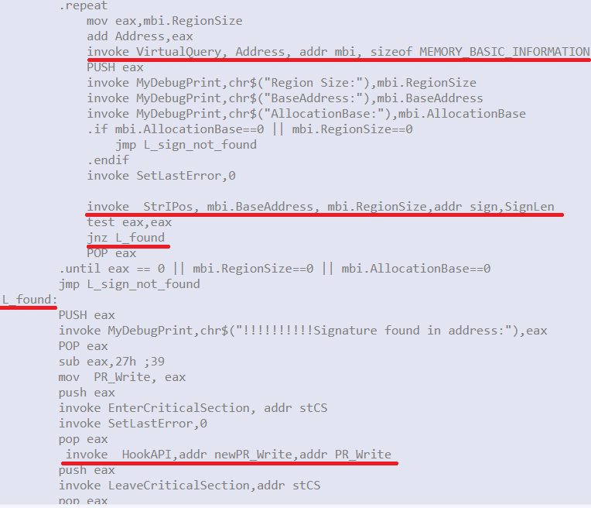
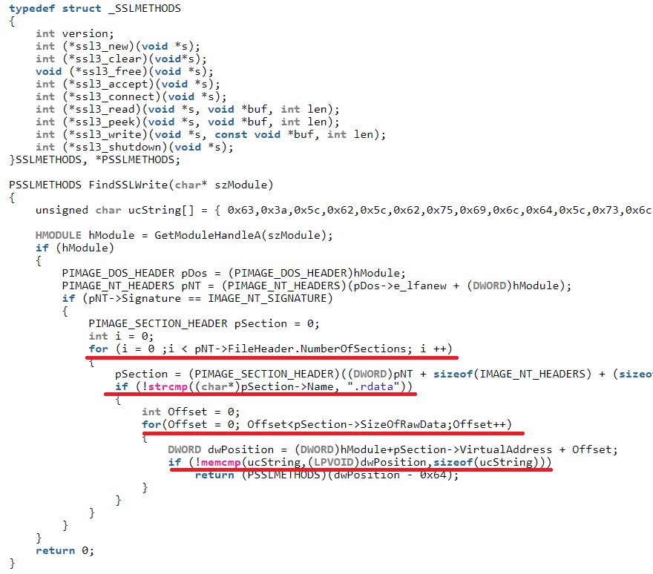

Slide 8
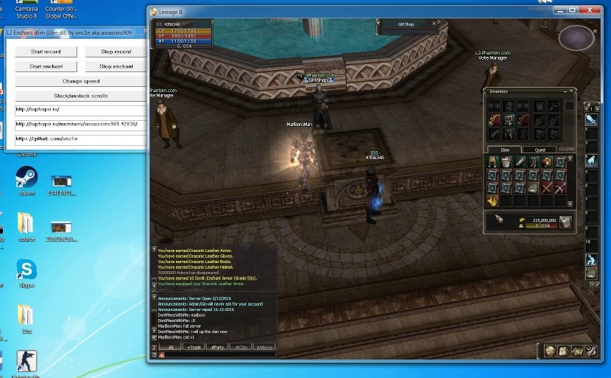
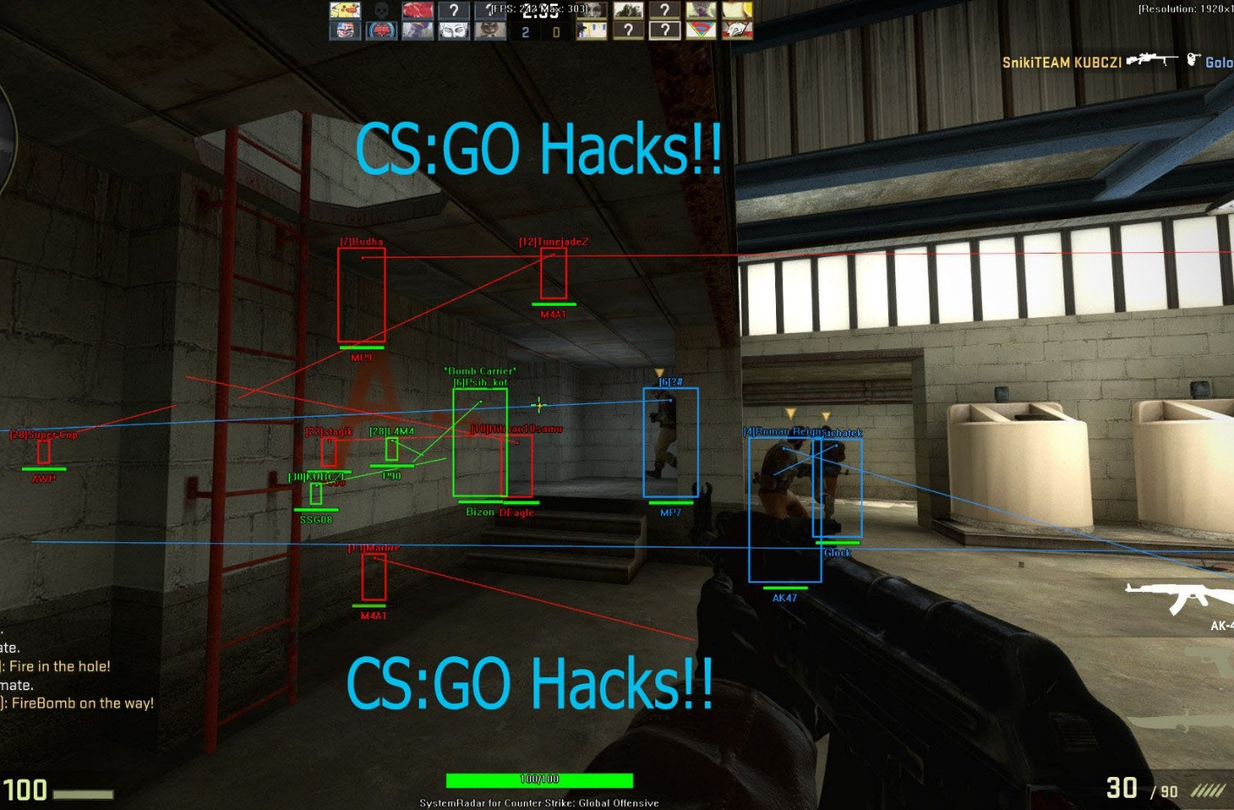
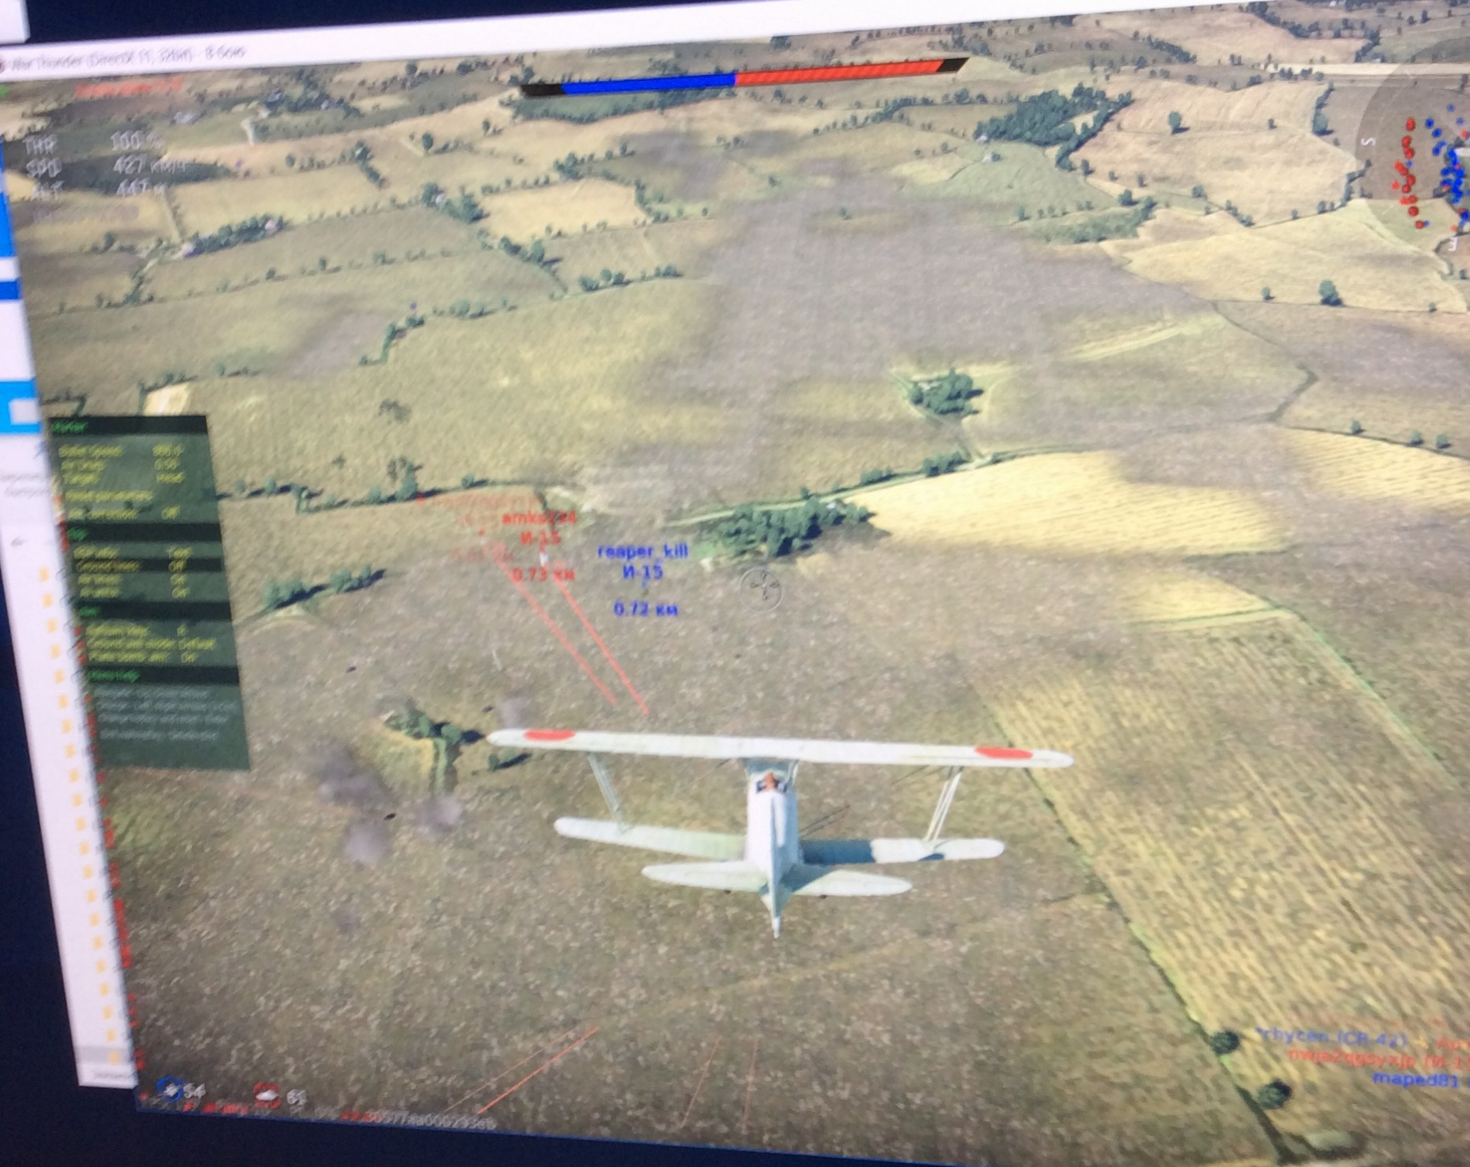


Slide 9
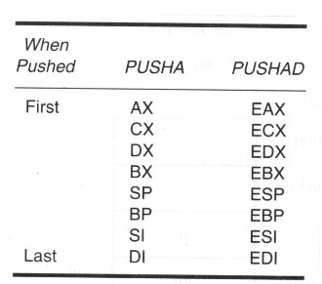
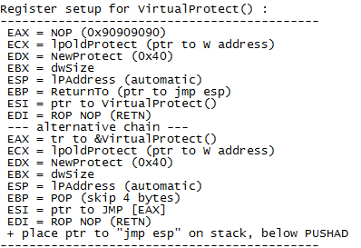
VirtualAlloc(MEM_COMMIT + PAGE_READWRITE_EXECUTE) + copy memory. This will allow you to create a new executable memory region, copy your shellcode to it, and execute it. This technique may require you to chain 2 API’s into each other.
HeapCreate(HEAP_CREATE_ENABLE_EXECUTE) + HeapAlloc() + copy memory. In essence, this function will provide a very similar technique as VirtualAlloc(), but may require 3 API’s to be chained together))
SetProcessDEPPolicy(). This allows you to change the DEP policy for the current process (so you can execute the shellcode from the stack) (Vista SP1, XP SP3, Server 2008, and only when DEP Policy is set to OptIn or OptOut)
NtSetInformationProcess(). This function will change the DEP policy for the current process so you can execute your shellcode from the stack.
VirtualProtect(PAGE_READ_WRITE_EXECUTE). This function will change the access protection level of a given memory page, allowing you to mark the location where your shellcode resides as executable.
WriteProcessMemory(). This will allow you to copy your shellcode to another (executable) location, so you can jump to it and execute the shellcode. The target location must be writable and executable.

Slide 10
Реализация

Slide 11
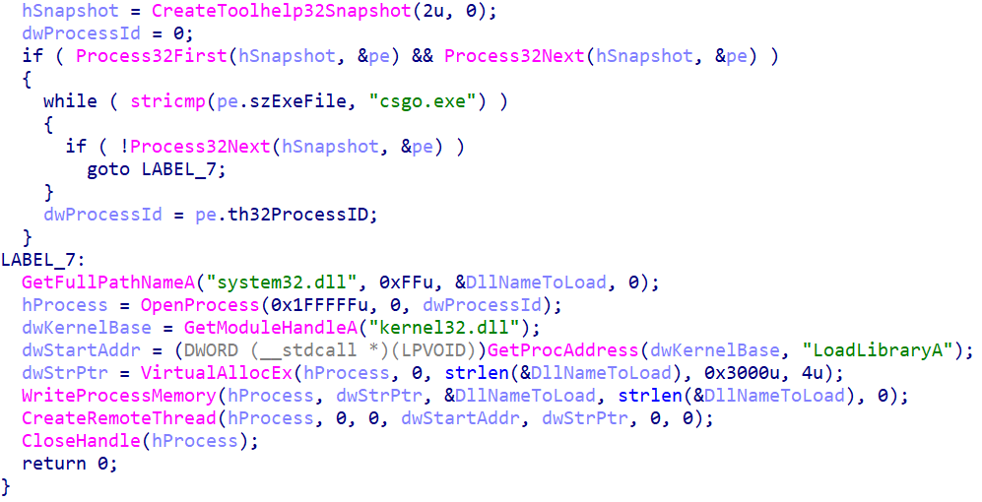
CreateRemoteThread && LoadLibrary

Slide 12
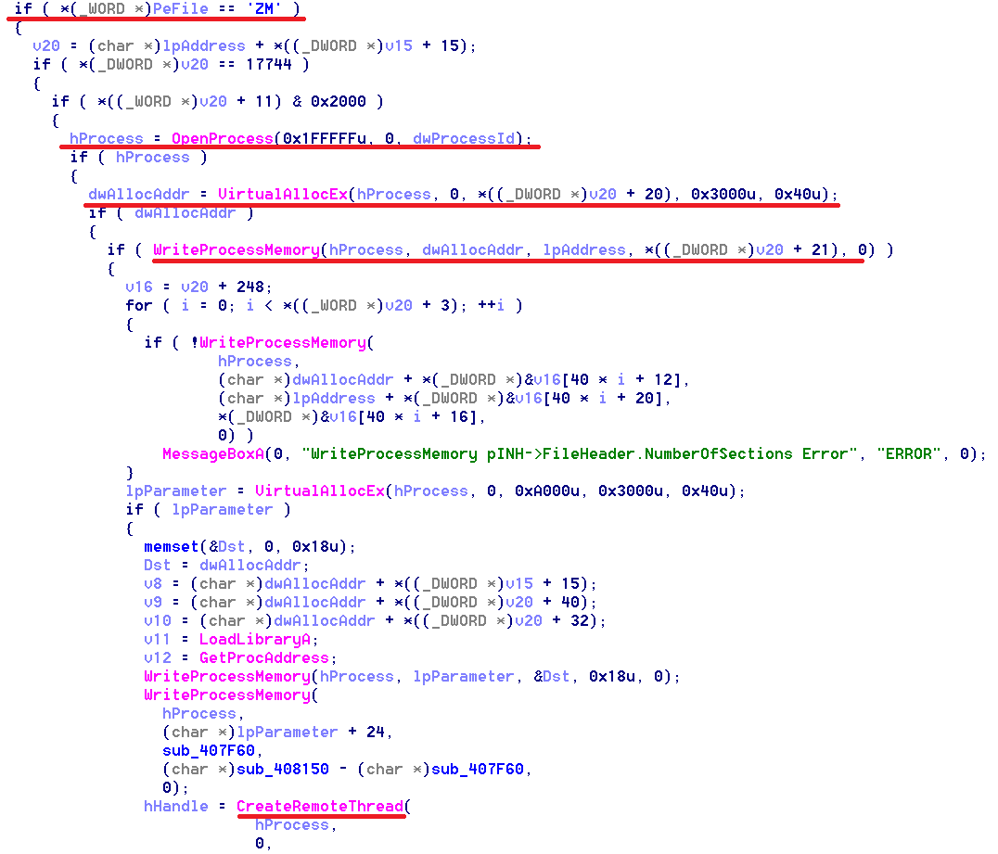
WriteProcessMemory && CreateRemoteThread

Slide 13
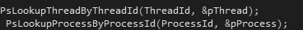
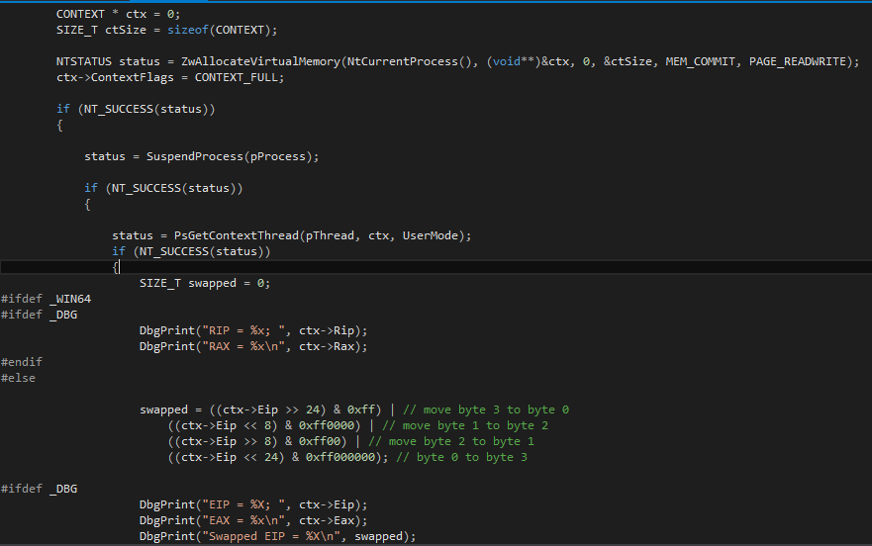
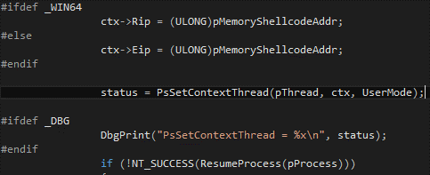
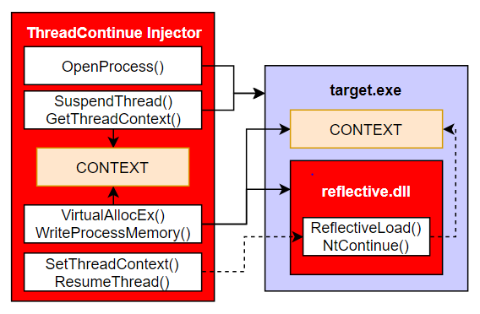
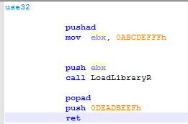
WriteProcessMemory && SetThreadContext

Slide 14
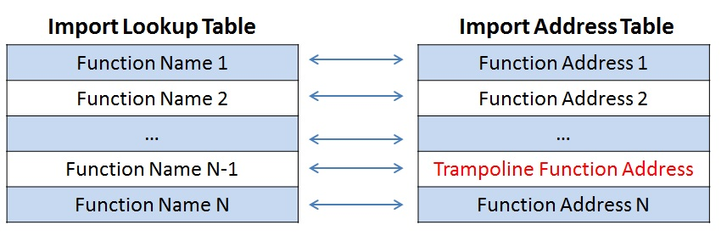
WriteProcessMemory

Slide 15
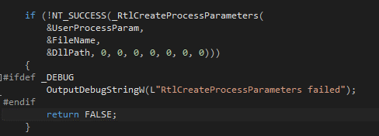
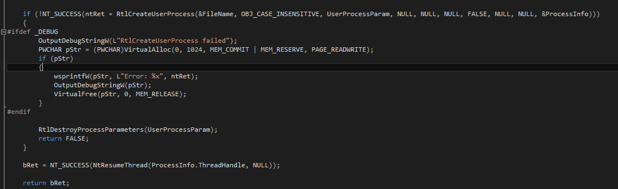
DLL hijacking
Search order:
The directory from which the application loaded. The current directory. The system directory. Use the GetSystemDirectory function to get the path of this directory. The 16-bit system directory. The Windows directory. Use the GetWindowsDirectory function to get the path of this directory. The directories that are listed in the PATH environment variable.

Slide 16
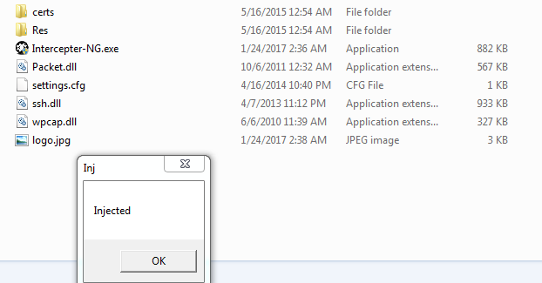
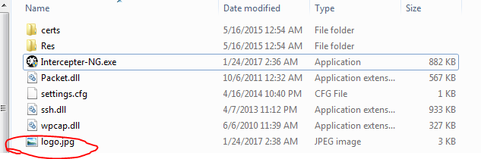
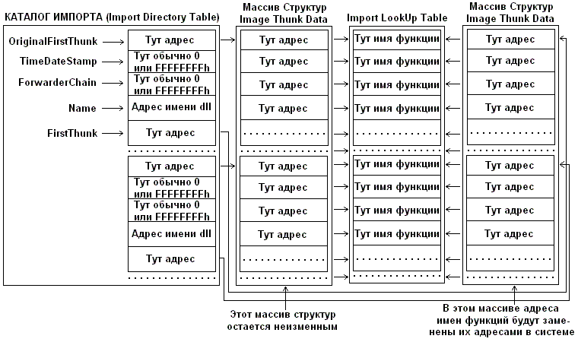
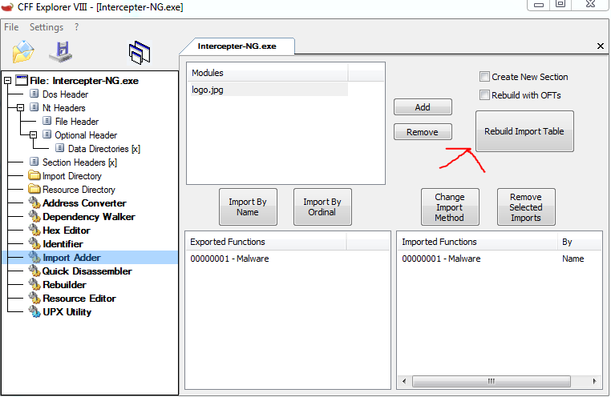
PE modifying

Slide 17
Защита

Slide 18
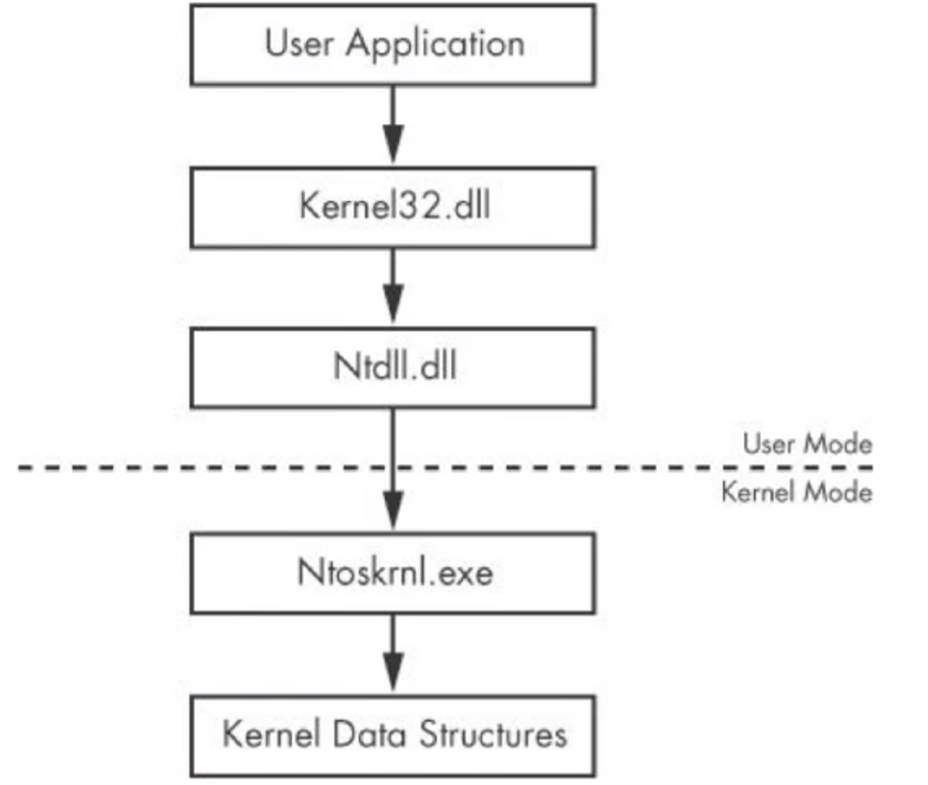

Slide 19
Перехват
LdrLoadDll
LdrGetDllHandleEx
LdrGetProcedureAddress
NtAllocateVirtualMemory
NtProtectVirtualMemory
NtWriteVirtualMemory
NtReadVirtualMemory
NtQueryInformationThread
NtContinue
NtSetContextThread
NtGetContextThread
NtCreateThread
NtOpenThread
NtSuspendThread
NtTerminateThread
NtOpenProcess
NtCurrentProcess
NtCurrentThread
NtCurrentTeb
NtClose
RtlAddVectoredExceptionHandler
RtlAddVectoredContinueHandler
Трассируем колл стек
Проверяем адресное пространство аргументов
Проверяем айди нити

Slide 20
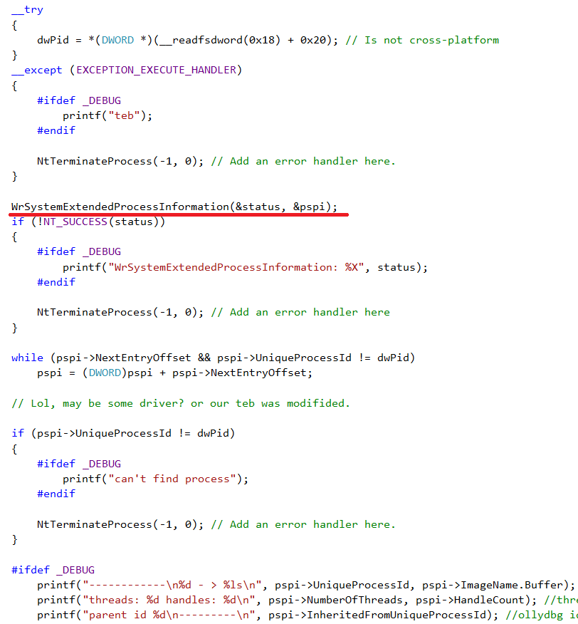
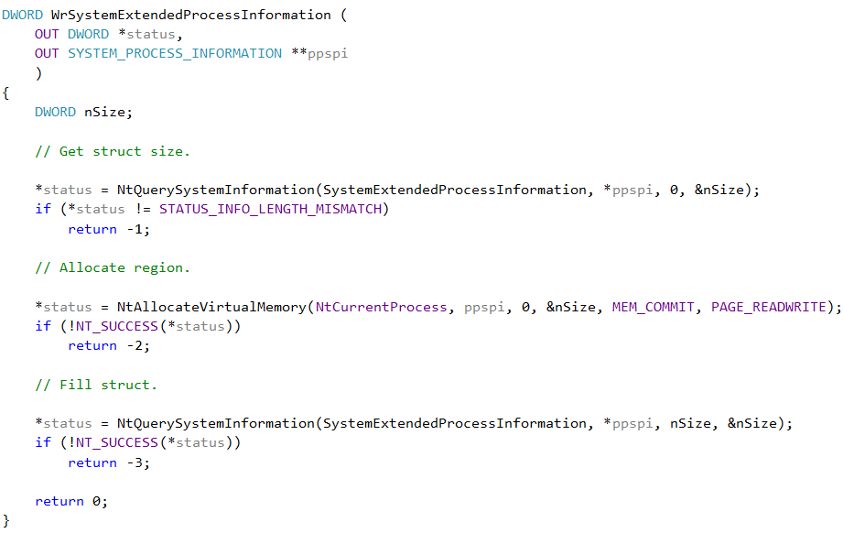
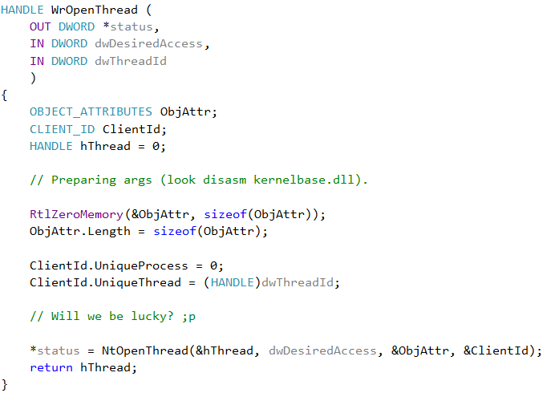
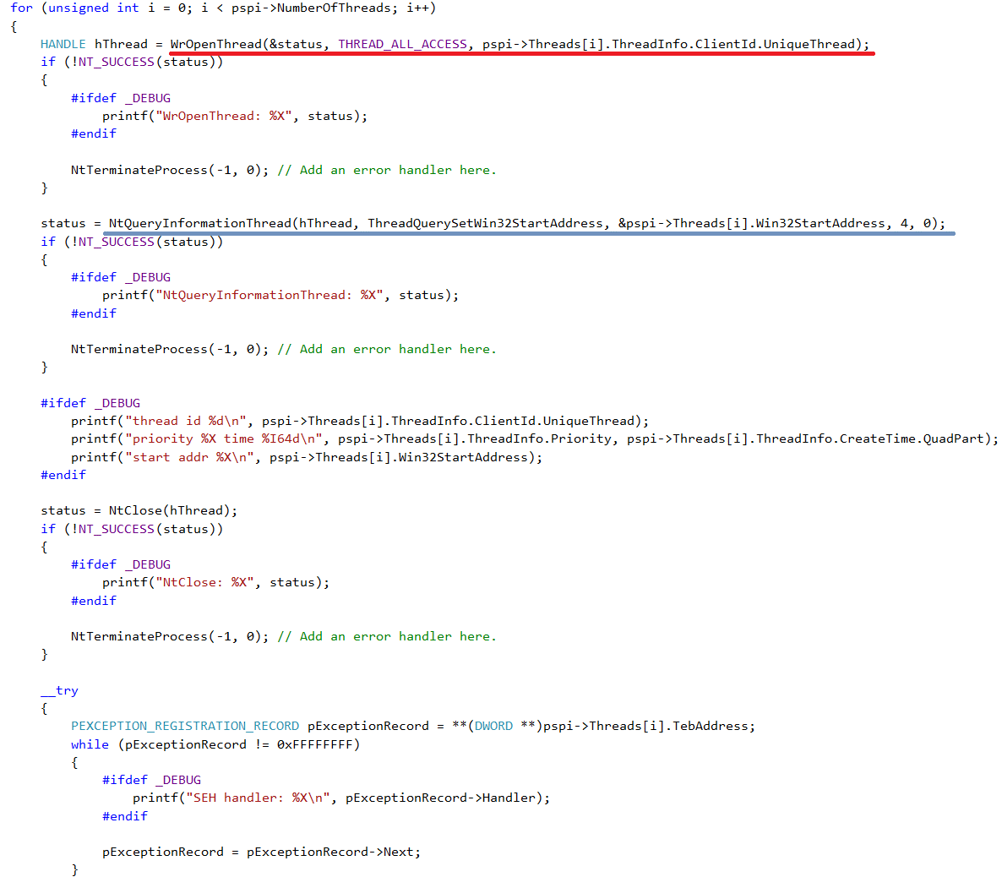
------------
1812 - > L2.exe
threads: 22 handles: 1052
parent id 6780
---------
thread id 11536
priority 9 time 131650229618495955
start addr 10922471
SEH handler: 767DFBF0
SEH handler: 101BE3A0
SEH handler: 10951BE0
SEH handler: 10951C28
SEH handler: 10952763
SEH handler: 10926840
SEH handler: 77096A50
SEH handler: 770A9EAE
thread id 4580
priority 8 time 131650229618608074
start addr 77053880
SEH handler: 77096A50
SEH handler: 77096A50
SEH handler: 770A9EAE
thread id 1752
priority 8 time 131650229618608906
start addr 77053880
SEH handler: 77096A50
SEH handler: 77096A50
SEH handler: 770A9EAE
Основная информация
thread id 12272
priority 8 time 131650229618731488
start addr 77053880
SEH handler: 77096A50
SEH handler: 77096A50
SEH handler: 770A9EAE
thread id 13096
priority 8 time 131650229624838032
start addr 10178300
SEH handler: 767DFBF0
SEH handler: 101BE4D0
SEH handler: 77096A50
SEH handler: 770A9EAE
thread id 2512
priority 8 time 131650229625323340
start addr 747698B0
SEH handler: 767DFBF0
SEH handler: 77096A50
SEH handler: 770A9EAE
thread id 10680
priority 8 time 131650229627050659
start addr 53F94A70
SEH handler: 767DFBF0
SEH handler: 6A2268E0
SEH handler: 6A22965D
SEH handler: 6A229690
SEH handler: 6A2296B3

Slide 21
Memory map
base: 5C415000 size: 1000 protect: 4
\Device\HarddiskVolume2\Windows\SysWOW64\msvcr120.dll
base: 5C416000 size: 1000 protect: 8
\Device\HarddiskVolume2\Windows\SysWOW64\msvcr120.dll
base: 5C417000 size: 7000 protect: 2
\Device\HarddiskVolume2\Windows\SysWOW64\msvcr120.dll
base: 5C41E000 size: 7002000 protect: 1
base: 63420000 size: 1000 protect: 2
\Device\HarddiskVolume2\Windows\System32\wow64.dll
base: 63421000 size: 33000 protect: 20
\Device\HarddiskVolume2\Windows\System32\wow64.dll
base: 63454000 size: 14000 protect: 2
\Device\HarddiskVolume2\Windows\System32\wow64.dll
DWORD dwAddr = 0;
DWORD dwRetLen;
MEMORY_BASIC_INFORMATION mbi;
char FilePath[0x210 + 8]; // UNICODE_STRING
while (NT_SUCCESS(NtQueryVirtualMemory(-1, dwAddr, 0, &mbi, sizeof(mbi), &dwRetLen)))
{
#ifdef _DEBUG
printf("base: %X size: %X protect: %X\n", mbi.BaseAddress, mbi.RegionSize, mbi.Protect);
#endif
if (NT_SUCCESS(NtQueryVirtualMemory(-1, mbi.BaseAddress, 2, FilePath, 0x210, &dwRetLen)))
{
#ifdef _DEBUG
printf("%ls\n", &FilePath[8]);
#endif
}
#ifdef _DEBUG
printf("\n");
#endif
dwAddr += mbi.RegionSize;
}

Slide 22
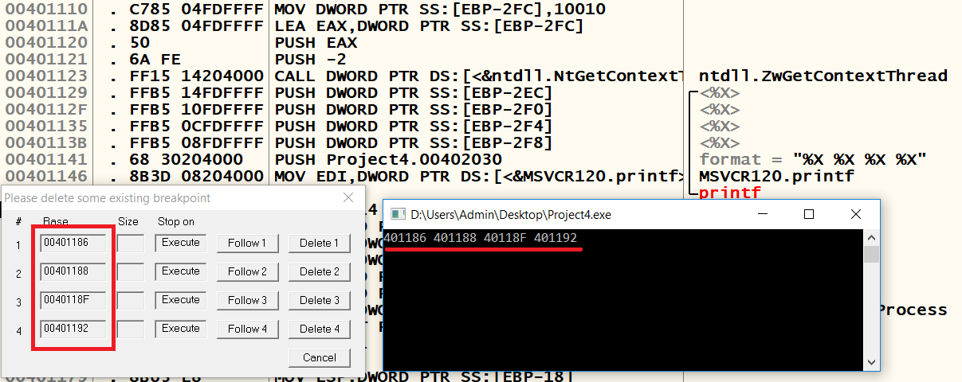
Hardware breakpoints
CONTEXT ctx;
ctx.ContextFlags = CONTEXT_DEBUG_REGISTERS;
NtGetContextThread(NtCurrentThread, &ctx);
if (ctx.Dr0 != 0 || ctx.Dr1 != 0 || ctx.Dr2 != 0 || ctx.Dr3 != 0)
{
// Detected
}

Slide 23
VEH
typedef struct _LdrpVectorHandlerList {
struct _LdrpVectorHandlerList *Prev;
struct _LdrpVectorHandlerList *Next;
DWORD Depth;
PVECTORED_EXCEPTION_HANDLER VectoredHandler;
} VECTORED_HANDLER_LIST, *PVECTORED_HANDLER_LIST;
PVECTORED_HANDLER_LIST VhlEntry;
PVECTORED_HANDLER_LIST VhlCurr;
DWORD dwAddr;
dwAddr = *(DWORD *)((DWORD)NtCurrentTeb()->
ProcessEnvironmentBlock->
Ldr->InInitializationOrderModuleList.Flink + 8); // Getting ntdll base. VX lvl ;P
dwAddr += 0x11931C; // _LdrpVectorHandlerList
VhlEntry = dwAddr;
VhlEntry = VhlEntry->Next;
VhlCurr = VhlEntry;
while (VhlCurr->Prev != VhlEntry)
{
#ifdef _DEBUG
printf("%X\n", RtlDecodePointer(VhlCurr->VectoredHandler));
#endif
VhlCurr = VhlCurr->Prev;
}

Slide 24
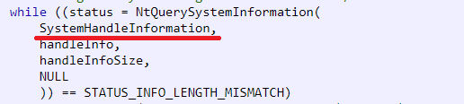
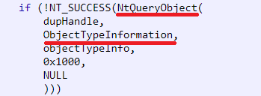
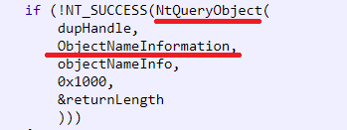
HANDLES
[0x1f8] Event: (unnamed)
[0x1fc] Thread: (unnamed)
[0x200] ALPC Port: (unnamed)
[0x204] TpWorkerFactory: (unnamed)
[0x208] IRTimer: (unnamed)
[0x20c] WaitCompletionPacket: (unnamed)
[0x210] IRTimer: (unnamed)
[0x214] WaitCompletionPacket: (unnamed)
[0x218] ALPC Port: (unnamed)
[0x21c] IoCompletionReserve: (unnamed)
[0x220] Event: (unnamed)
[0x224] WaitCompletionPacket: (unnamed)
[0x228] WaitCompletionPacket: (unnamed)
[0x22c] WaitCompletionPacket: (unnamed)
[0x230] Thread: (unnamed)
[0x234] WaitCompletionPacket: (unnamed)
[0x238] Thread: (unnamed)
[0x23c] ALPC Port: \BaseNamedObjects\[CoreUI]-PID(17040)-TID(9756) 9fa64fbd-3aec-41f3-8e23-3e593b73844d
[0x240] WaitCompletionPacket: (unnamed)
[0x244] ALPC Port: (unnamed)
[0x248] WaitCompletionPacket: (unnamed)
[0x250] Process: (unnamed)
cplusplus.com/forum/windows/95774/

Slide 25
HWND
typedef struct HwndList_s
{
ULONG MaximumLength;
ULONG Length;
HWND hwnd[1];
} HwndList_t;
ULONG len;
DWORD nSize;
HwndList_t *hl = 0;
NtUserBuildHwndList(0, 0, 0, 1, 0, 0, 0, &len);
nSize = len * 4 + 8;
NtAllocateVirtualMemory(-1, &hl, 0, &nSize, MEM_COMMIT, PAGE_READWRITE);
hl->MaximumLength = len;
hl->Length = 0;
NtUserBuildHwndList(0, 0, 0, 1, 0, hl->MaximumLength, hl->hwnd, &hl->Length);
QWidget
PPTFrameClass
#32770
tooltips_class32
Notepad++
AnsiTranslationWindowClass
OfficePowerManagerWindow
OleDdeWndClass
MsoStdCompMgr
ThreadMsgWinClass
PPT16ProcessClass
ARC Window Class
ApplicationManager_DesktopShellWindow
OLLYDBG
UIRibbonStdCompMgr
WorkerW
Chrome_WidgetWin_1
Chrome_WidgetWin_1
QWidget
HwndlessEditorFakeHwndWrapperb396b4f4-e20d-44e3-ac90-73b7fb66ccad
tooltips_class32
HwndlessEditorFakeHwndWrapper43a28a74-39d1-48b6-aa85-4c46baa61dda
HwndlessEditorFakeHwndWrapper55e0f443-7463-4226-b148-45d5844b3e04
HwndlessEditorFakeHwndWrappere80cf03b-9a0a-45fc-97cd-568b04cc7d8e
HwndlessEditorFakeHwndWrapper9a84454c-cdcf-47df-9be7-63d53ffa3ed1
ComboLBox
NtUserQueryWindow(HWND hwnd, WINDOWINFOCLASS WindowInfo);
NtUserGetClassName(HWND hwnd, BOOL bReal, PUNICODE_STRING pstrClassName);
NtUserInternalGetWindowText(HWND hwnd, LPWSTR lpString, int nMaxCount);

Slide 26
DACL
HANDLE WINAPI OpenProcess( _In_ DWORD dwDesiredAccess, _In_ BOOL bInheritHandle, _In_ DWORD dwProcessId );
dwDesiredAccess [in]
The access to the process object. This access right is checked against the security descriptor for the process. This parameter can be one or more of the
process access rights.
If the caller has enabled the SeDebugPrivilege privilege, the requested access is granted regardless of the contents of the security descriptor.
ACL acl;
RtlZeroMemory(&acl, sizeof(acl));
InitializeAcl(&acl, sizeof(acl), ACL_REVISION);
SetSecurityInfo(-1, SE_KERNEL_OBJECT, DACL_SECURITY_INFORMATION, 0, 0, &acl, 0);

Slide 27
DEP / ASLR
#pragma comment(linker, "/DYNAMICBASE")
DWORD dwFlags = 0x01;
NtSetInformationProcess(NtCurrentProcess, ProcessExecuteFlags, &dwFlags, 4);

Slide 28
IAT / EAT / VMT / sections / etc (RAM + disk)
DWORD dwBase;
PIMAGE_DOS_HEADER pImageDosHeader;
PIMAGE_NT_HEADERS pImageNtHeaders;
PIMAGE_IMPORT_DESCRIPTOR pImageImportDescriptor;
PIMAGE_THUNK_DATA pImageThunkData;
PIMAGE_IMPORT_BY_NAME pImageImportByName;
dwBase = *(DWORD *)(__readfsdword(0x30) + 0x08);
pImageDosHeader = dwBase;
pImageNtHeaders = dwBase + pImageDosHeader->e_lfanew;
pImageImportDescriptor = dwBase + pImageNtHeaders->OptionalHeader.DataDirectory[IMAGE_DIRECTORY_ENTRY_IMPORT].VirtualAddress;
while (pImageImportDescriptor->Name)
{
#ifdef _DEBUG
printf("%s\n", dwBase + pImageImportDescriptor->Name);
#endif
if (pImageImportDescriptor->OriginalFirstThunk)
pImageThunkData = dwBase + pImageImportDescriptor->OriginalFirstThunk;
else pImageThunkData = dwBase + pImageImportDescriptor->FirstThunk;
while (pImageThunkData->u1.Ordinal)
{
if (pImageThunkData->u1.Ordinal & IMAGE_ORDINAL_FLAG32)
#ifdef _DEBUG
printf("Ordinal: %X\n", pImageThunkData->u1.AddressOfData && 0xFFFF);
#endif
else
{
pImageImportByName = dwBase + pImageThunkData->u1.Ordinal;
#ifdef _DEBUG
printf("Name: %s\n", pImageImportByName->Name);
#endif
}
pImageThunkData++;
}
pImageImportDescriptor++;
}
ntdll.dll
Name: DbgPrint
Name: NtOpenThread
Name: NtAllocateVirtualMemory
Name: NtClose
Name: NtQueryInformationThread
Name: NtQuerySystemInformation
Name: DbgPrintEx
Name: NtTerminateProcess
MSVCR120D.dll
Name: wcscpy_s
Name: _wmakepath_s
Name: _wsplitpath_s
Name: _except_handler4_common
Name: __crtTerminateProcess
Name: _crt_debugger_hook
Name: _CRT_RTC_INITW
Name: printf
Name: _getch
Name: memset
Name: __crtUnhandledException
KERNEL32.dll
Name: GetModuleHandleW
Name: GetModuleFileNameW
Name: FreeLibrary
Name: VirtualQuery
Name: GetProcessHeap
Name: HeapFree
Name: HeapAlloc
Name: WideCharToMultiByte
Name: MultiByteToWideChar
Name: LoadLibraryExW
Name: GetProcAddress
Name: GetLastError
Name: RaiseException
Name: IsProcessorFeaturePresent
Name: IsDebuggerPresent
Name: OutputDebugStringW

Slide 29
Примечания
Зависимость от системы (версия, разрядность)
Вызовы напрямую (int 0x2e, sysenter), нэйтив образ с диска, контроль другим процессом
SystemModuleInformation, RtlpStkIsPointerInDllRange
EWMI, APC injection
WinHTTP, Direct3D, OpenGL
Срыв стека (невалидный стек ниже сторожевой страницы)
Упаковка, антидебаг, обфускация
Сheat Engine, Process Hacker, OllyDbg, x64dbg, rewolf wow64ext, Windows 2000, WRK, Wine

